Slide 1
Writing A Successful Proposal
CSE 593
Dr. Yinong Chen

Slide 2
Design Process
Define Problem
Requirement
Specification
Initial Research
Generate
Solutions
Proposal
Proposal
Decide Course
of Action
Approval
Approval
Plan
Implementation
Carry Though
Follow Up
Final
Evaluation

Slide 3
Proposal and Approval
A highly competitive proposal must be excellent in
Summary
Motivation/Rationale/ Goals and Objectives: Why
Problem description: What
Approach/Methodology to solve the problem: How
Schedule/Plan
Budget
Qualification of the proposers (bios / CV)
Proposal review and evaluation
Short listing
Site visiting and presentation
Approval/Disapproval
Longest part

Slide 4
Heilmeier’s Criteria of Proposal Writing
What are you trying to do? Articulate your objectives using absolutely no jargon.
How is it done today, and what are the limits of current practice?
What's new in your approach and why do you think it will be successful?
Who cares? If you're successful, what difference will it make?
What are the risks and the payoffs?
How much will it cost? How long will it take?
What are the midterm and final "exams" to check for success?

Slide 5
Types of Proposals
Formal
Solicited
External
Competitive
Unsolicited
Proposals
Less formal
Solicited
Internal
Unsolicited

Slide 6
National Sources of Funding (Examples)
NSF
Foundation
SFAz
SBIR
STTR
IBM
Industry
Intel
DARPA
Microsoft
Sources
Army
DoD
Air force
Government
DoE
Navy
US Ed
Others
NSF

Slide 7

What are SBIR and STTR?
SBIR and STTR
provide more than $2 billion a year to small companies that are developing leading-edge technologies of interest to federal agencies.
provide companies with seed capital of up to $850,000 to develop technologies that can lead to commercial products.
Sponsored by
DARPA: Defense Advanced Research Projects Agency
NSF: National Science Foundation

Slide 8
SBIR / STTR Sponsored Projects -- Samples

Slide 9
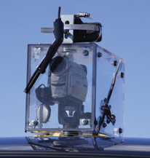
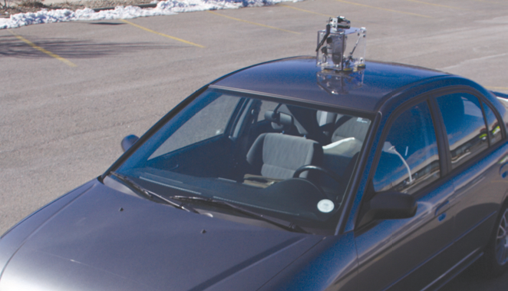
SBIR and STTR Sponsored Projects
GTVS: Glass Turret Visualization System: A Pathfinder

Slide 10
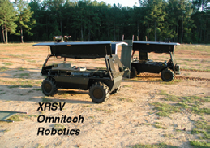
SBIR and STTR Sponsored Projects
Smart Robots Create Value by Increasing Personal Safety:
Omnitech Robotics International LLC focused on development of a miniature robotic vehicle, which led to the development of TOUGHBOT, a robot
being used in Iraq to aid in surveillance, building entry, and clearing operations

Slide 11
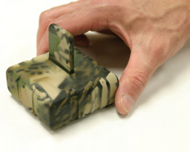
SBIR and STTR Sponsored Projects
Ground Motion Detection Sensor:
While there are numerous products
available when selecting
ground sensors for detecting the
movement of people, these options
are often relatively expensive.
Under this SBIR, Time Domain
Corporation developed a low-cost, long endurance unattended ground sensor
(UGS) that has a low incidence of false
alarms, has its own communications
system, and can self-locate.

Slide 12
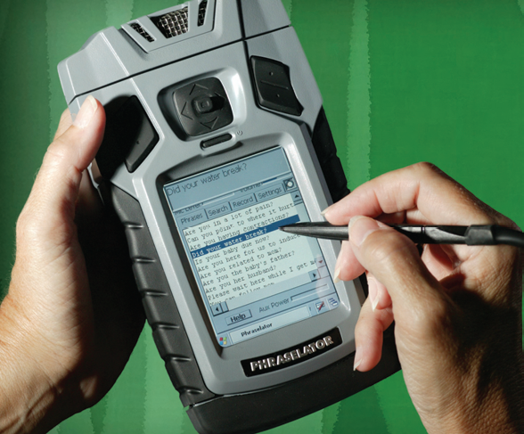
SBIR and STTR Sponsored Projects
Real-Time Language Translation Tools Assist:
After the events of 9/11 and the military’s initiation of operations in Afghanistan, there was an immediate need for a small handheld device that would allow U.S. military personnel to communicate with local people in areas of deployment

Slide 13
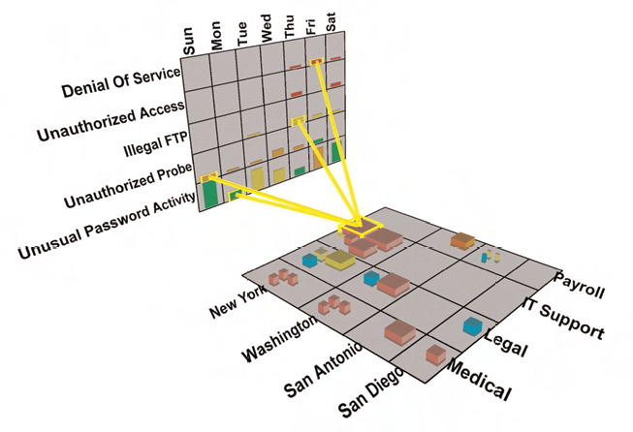
SBIR and STTR Sponsored Projects
3-D Images Help Thwart Attacks:
SecureScope takes security data that comes from many sources and, by way of a data-rich 3-D presentation, displays it in the proper context to help information security analysts make informed decisions about potential threats and
the subsequent impact of information security breaches

Slide 14
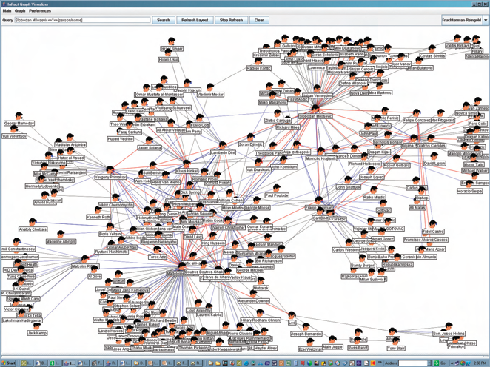
SBIR and STTR Sponsored Projects
Enhanced Search Engine:
developed by Insightful Corporation (Insightful) under SBIR helps analysts work through document-ation more quickly and efficiently than traditional technologies, such as keyword search or simple entity extraction software.
The program comprises two distinct parts:
(1) a new algorithm for latent semantic analysis, and
(2) deep parsing technology for relationship extraction from unstructured information

Slide 15
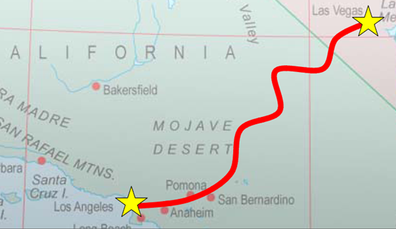
DARPA Grand Challenge: Autonomous Ground Vehicle www.darpa.mil
From Los Angeles to Las Vegas, 200+ miles of toughest terrain in the world;
First competition in 2004, and the first place would take $1 million dollar cash prize. No vehicle made it;
In 2005, the prize was increased to $2 million. Multiple vehicle made to the destination;

Slide 16
What to Propose?
What are needed, and what you can do?
FOCUS on your strengths – not just the current trend of the day (“Nano”, “9-11”, or something interesting you saw on the Discovery Channel)
Establish a plan for yourself based upon your expertise:
Where are the frontiers of knowledge/how can your approach be innovative?/what contribution will you make?
Who else is tackling these issues?
What recent awards have been made/what funding sources are available?
Have there been recent advances/breakthroughs?
What has been published - globally?
Is there a broader interest than just defense?

Slide 17
SBIR/STTR Request for Proposals (RFPs) and Awards

Slide 18
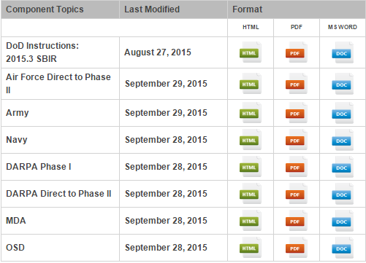
SBIR Request for Proposals (RFPs) Example: DoD 2015.3 SBIR Solicitation
http://www.acq.osd.mil/osbp/sbir/solicitations/index.shtml

Slide 19
SBIR Request for Proposals (RFPs) Examples
http://www.acq.osd.mil/osbp/sbir/solicitations/index.shtml
Multi-Material Structures
Handheld Sensor for Amorphous Coating Integrity
Combat Resilience: Inoculating the Warfighter Against Combat Stress
Massively Distributed Problem-Solving (MDPS)
Tactile Detection Robotic Hand System
Real-Time Autonomous Reasoning for Satellite Defense
Automated Collaboration Sensors for Networked Command and Control
Foveated Vision Technologies
Widely-Tunable Photonic Millimeter Wave Generator
High Sensitivity/Throughput Biosensor for Bioagent Detection and Identification
Ultraviolet (UV) Imaging Focal Plane Arrays
Fast, Narrow Linewidth Near Infrared (NIR) / Shortwave Infrared (SWIR) Scanner
Inexpensive, Portable Sensors for Chemical-Biological Agent Detection
Energy Collection and Storage Systems for Re-Entry Modules
…

Slide 20
RFP: Tactile Detection Robotic Hand System
OBJECTIVE: Design and build a robot hand to identify objects using only tactile feedback, similar to the skin on a human hand.
DESCRIPTION: Human beings are successful in part due to our ability to reason and utilize tools. A key component of this ability is the flexibility, speed, and sensitivity of our hands to manipulate our environment. Recent trends in robotic development have improved multi-fingered hand technologies. However, existing technologies do not offer sensitive tactile feedback like human skin, incl. its ability to determine size, weight, thermal characteristics, and texture of an object. To illustrate, imagine reaching into a backpack to grasp an umbrella, which would be identified by touch alone.
DELIVERABLE: A prototype robotic hand system, including skin and muscles (actuators), will be developed. This system will be measured by its performance on a “Tactile Object Recognition” task. In this task, the robot hand system will be presented with several objects that vary in their physical characteristics (e.g. a block of wood, a brick, a stuffed animal, and a feather), and asked to select the appropriate object from the set using only its skin and muscles to make the determination.

Slide 21
Award: High Performance Hydraulic Actuation for Mobile Robots
OBJECTIVE: The project addresses three fundamental challenges to the broad adoption of hydraulic actuation in small mobile robotic applications: poor efficiency, poor controllability, and noisy operation.
DESCRIPTION: Component level and system level innovations will be combined for a novel, integrated approach to hydraulic actuation which overcomes these challenges. Hydraulics research has received relatively little attention since the 1950's, hence there are significant opportunities for improvement. Hydraulics research is important because no other actuation technology has come close to matching the power-density (strength X speed / weight) of hydraulic systems, and power density is critical for robots intended to do real work.
http://www.nsf.gov/awardsearch/showAward.do?AwardNumber=0945411&WT.z_pims_id=503361

Slide 22
Award: Media Cloud: Distributed Computing System for Online Rich Media Creation
OBJECTIVE: Develop an online system for the creation and distribution of rich media content - video and computer animation.
DESCRIPTION: The system will provide a service to both non-professional consumers and professionals in the media-production industry. The architecture is necessitated by the confluence of:
the wide scale adoption of social networking and online media sharing websites;
the nascent video editing and rendering capabilities currently offered online, largely restricted to linear editing capabilities, and lacking support for multi-stream and collaborative editing. The approach will automatically configure, schedule, and manage multiple virtualized storage and compute resources (a compute and storage Cloud) needed for complex complete media processing workflows, leveraging advanced commodity hardware acceleration, virtualized compute resources, and a cognitive model of film editing to support prosumers in executing advanced editing and post-production operations
http://www.nsf.gov/awardsearch/showAward.do?AwardNumber=0944407&WT.z_pims_id=503361

Slide 23
How to Write: One Page Summary The Most Important Page
What: Clearly state the research objectives
Why: Is this research/product needed? Justification!
How: Describe the major research/development tasks and how they meets intellectual merit and broader impacts
What is the intellectual merit of the project
How important is the proposed activity to advancing knowledge and understanding within its own field or across different fields?
To what extent does the proposed activity explore creative and original concepts?
What are the broader impacts?
Will the results be disseminated broadly to enhance scientific and technological understanding?
What may be the benefits to the community and the society?

Slide 24
How to Write the Main Part of the Proposal
Solicited proposals always have a given format and limit in length
Use the space wisely - clarity of thought and brevity of word - more is not always better.
On Page 1 - state what you are going to do and why - don’t make reviewers wait until page 7, it shouldn’t be a mystery.
Can elaborate the summary, but not simply repeat
Make at least the introduction understandable to any technically educated person. Not all members of the panel will be expert in your sub-discipline.
Page limits/fonts/margins ARE important - don’t use small fonts to get more stuff in your proposal - don’t disqualify your proposal ! ! !

Slide 25
How to Write the Main Part of the Proposal
Pages 2-15
LAY THE GROUNDWORK (Introduction)
Discuss and acknowledge the work of others
Motivation
Demonstrate your prior work
Define your problem and explain the strength of your work
THEN
Lay out your research plan (an idea is not enough)
Method of validating results
How you handle obstacles
Broader impacts, including education, environment, energy, economics, and safety and security

Slide 26
Other Parts of the Proposal
Budget and Budget Justification, assuming that you will be actually creating the proposed system, including
personal cost,
equipment,
software licenses,
parts and materials, etc.
List of references cited in the main proposal.
Professional biographies of investigators.
Other supporting documents that can help the review to understand particular issues in the proposal.

Slide 27
What makes a proposal competitive?
Original ideas
Succinct and focused project plan
Cost effective
Knowledge and experience in the discipline
Experience in essential methodology
Realistic amount of work
Sufficient detail
Strong rationale or evidence of potential effectiveness

Slide 28
Common Reasons for High Ratings
“This proposal suggests a clear, elegant, well-documented approach to a problem that has plagued this field for decades.”
“The investigator has a beautiful plan. Students can step right into this work, yet it solves a major problem and will be publishable in a first-rate journal.”
“This is certainly adventurous, and I frankly would have doubted it could be done. Yet the investigator has proven the method in preliminary work AND had it accepted by a peer-reviewed journal!”
“This reads like a dream. I have rarely seen a proposal, even from long-established investigators, that shows such careful thought and meticulous presentation.”

Slide 29
Common Reasons for Low Ratings
No well defined hypotheses or tests of same. Lack of focus. “Why all the rambling, this seems like a fishing expedition.”
“What does that component have to do with the central focus of the proposal?”
Important information on experimental and sampling procedures is omitted. “I really can’t tell what is going to be done and how.”
The work can certainly be carried out, but it doesn’t address any topic of broad current interest. “I would probably not read a paper describing the results.”
Scope of the work is out of proportion to the budget and amount of time needed to do the work.

Slide 30
CSE593 Proposal Outline
For more detail, please read the Word document on Proposal Outline
Proposal Contents
Title page
Table of contents
Summary (1 page)
Introduction (2 pages)
Related work (2 pages)
Methodology, alternative designs, and approach, anticipated results and deliverables (6 – 8 pages)
Project planning and management (2 pages)
Conclusion and summary
References
Professional biography
Formatting requirement
Professionalism in writing: single spacing, 12-point font, grammar, spelling, punctuation, language, consistency;
Writing tips followed (in report writing lecture)

